Slide 1
Natural Language Processing
Unit 2
Faizan Javed
DataScience @ SMU

Slide 2
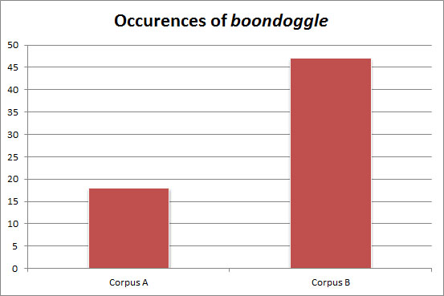
A primer on normalization
Count of the word “boondoggle” in two corpus.
18 in corpus A
47 in corpus B
Any inference issues here?
Notes:
http://www.thegrammarlab.com/?nor-portfolio=normalizing-word-counts

Slide 3
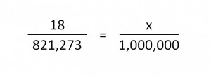
What is are the relative frequencies?
Corpus A = 821,273 words, Corpus B = 4,337,846 words.
Raw frequencies:
Corpus A = 18 per 821,273 words
Corpus B = 47 per 4,337,846 words
Scale: Compute per 1m words

Slide 4
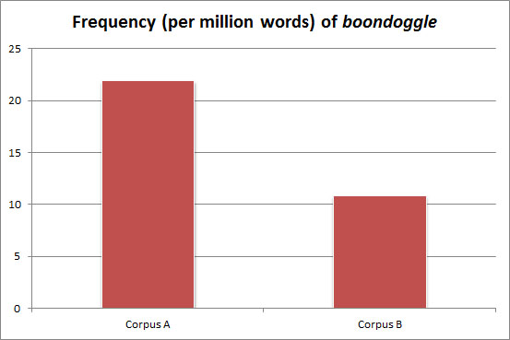
The raw frequencies show that boondoggle appeared more than 2.5 times more in Corpus B.
The normalized frequencies, however, show that boondoggle is twice as frequent in Corpus A.

Slide 5
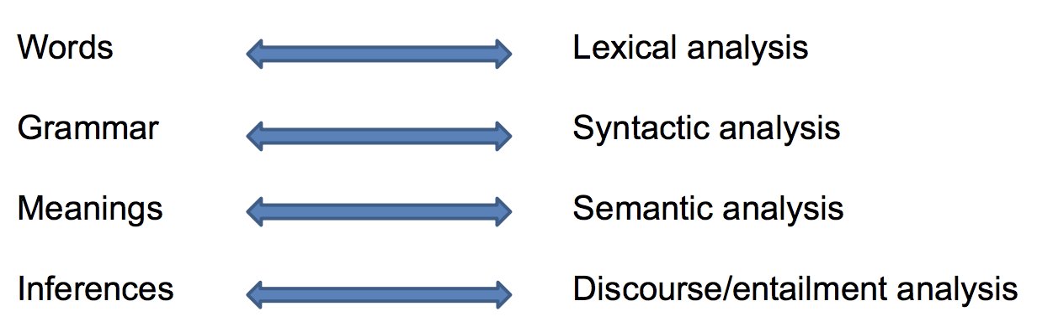
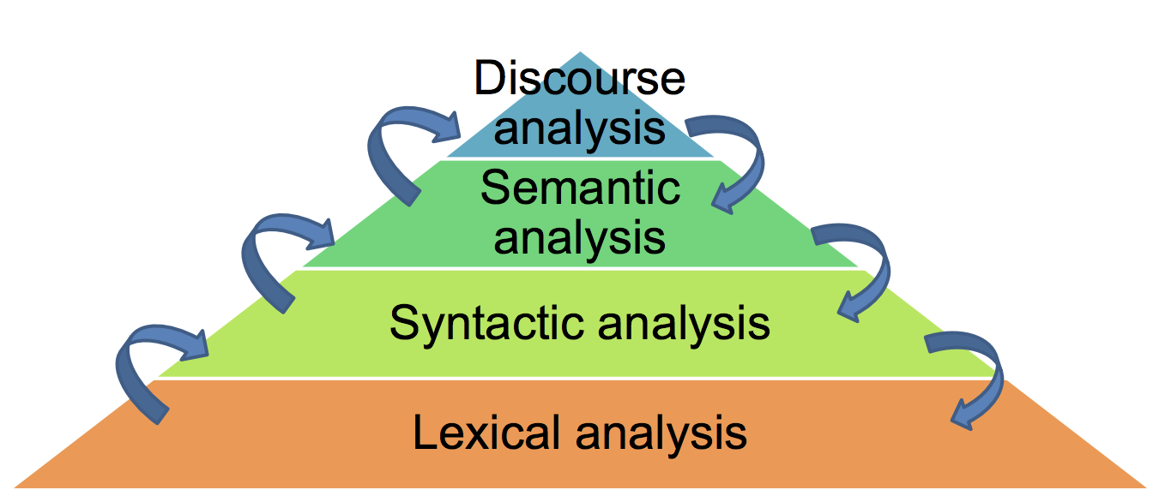
Levels of Analysis in NLP

Slide 6
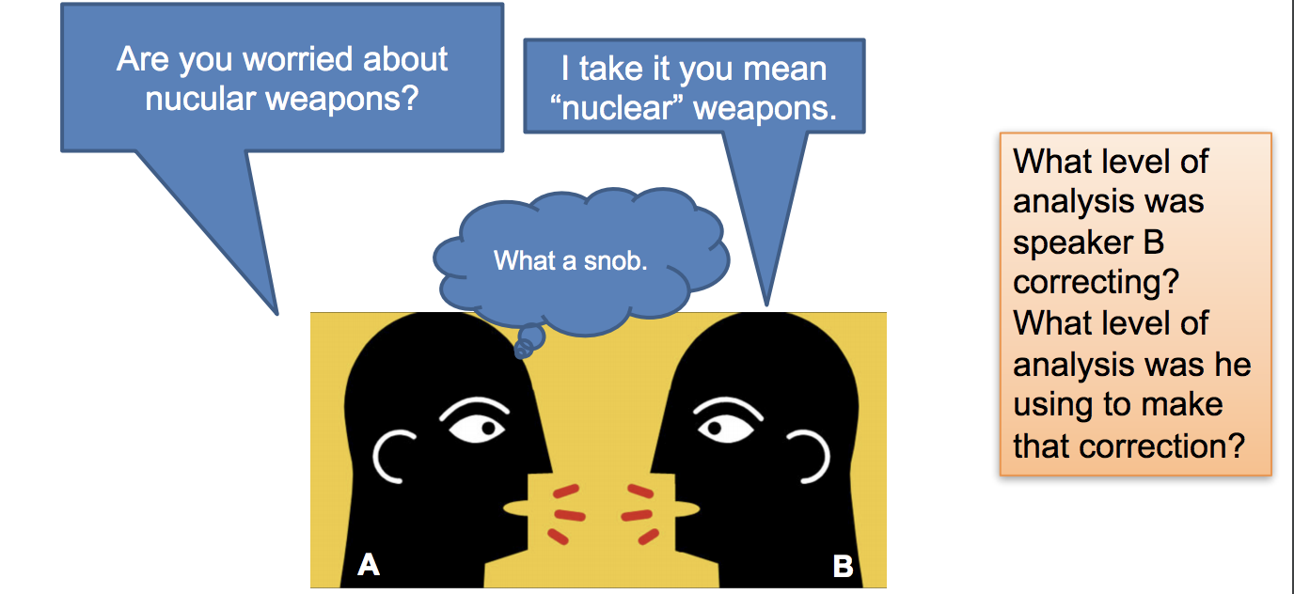
Multi-level analysis

Slide 7
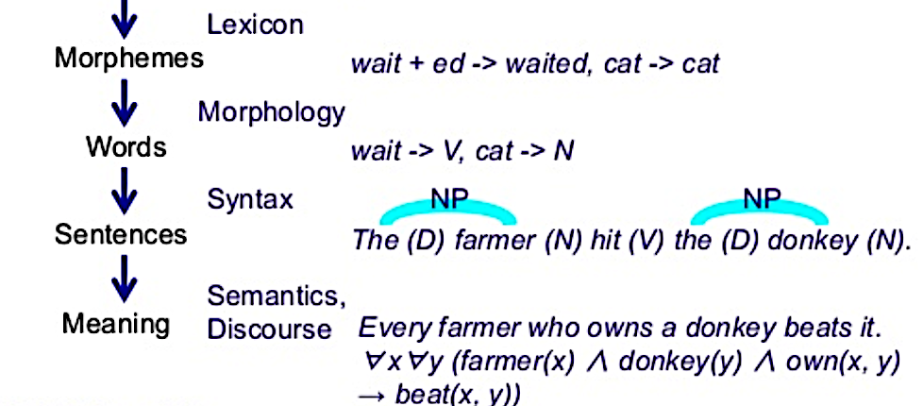
Syntax vs Semantics

Slide 8
Lexical analysis: Tokenization
Token: word – sequence of characters
Tokenization: convert a string of characters into a sequence of tokens
Separator: tabs, spaces
Punctuations, hyphens and apostrophes
What about numbers, e.g., 100, alphanumeric words, e.g., EC2, and symbols?
Example: How would you tokenize:
I can't believe that the Carolina Hurricanes won the 2005-2006 Stanley Cup.

Slide 9
Lexical analysis: Tokenization

Slide 10
Lexical analysis: Stemming and Lemmatization
Inflections: syntactic differences between words
Toy vs Toys , Universe vs University
Stemming: reducing a word to its root form
Lemmatization: uses lexical knowledge bases such as WordNet to obtain word base forms
Porter stemmer examples:
apple, apples --> appl
meanness, meaning --> mean
What are the trade-offs between aggressive and light stemming?

Slide 11
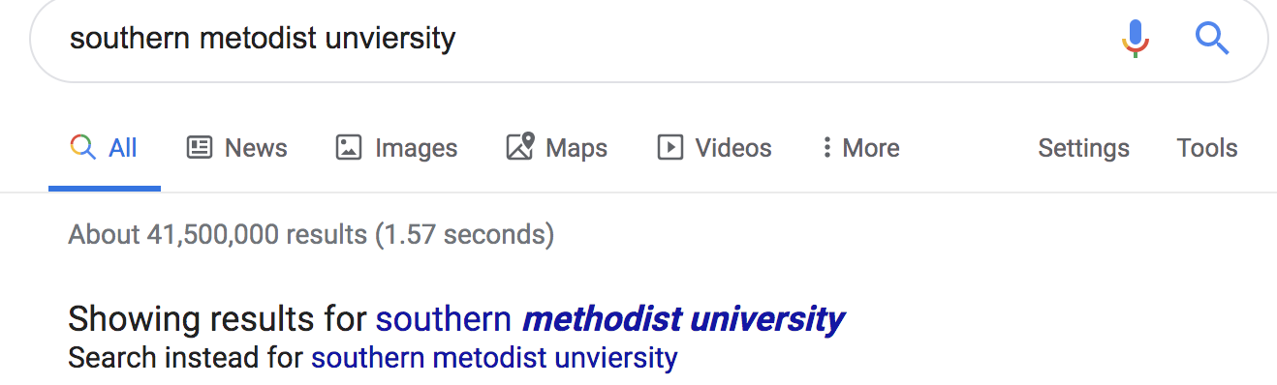
Lexical analysis: Applications
Lexical diversity measurement
Spell correction:
Peter Norvig’s classic post
http://norvig.com/spell-correct.html
Multi-Candidate Ranking Algorithm Based Spell Correction, Home Depot, Ecom SIGIR 2019
https://sigir-ecom.github.io/ecom2019/ecom19Papers/paper9.pdf

Slide 12
Lexical analysis: Spell correction
Offline:
Indexing Tokens. Building the index for candidate generation.
Build a language model. Model that estimates the a priori probability of an intended query.
Building an error model. Edits– Edit distance?
Query time:
Candidate generation. Identifying the spelling correction candidates for the query.
Scoring. Computing the score or probability for each candidate.
Presenting suggestions. Determining whether and how to present a spelling correction.
Peter Norvig’s classic post
http://norvig.com/spell-correct.html
Multi-Candidate Ranking Algorithm Based Spell Correction, Home Depot, Ecom SIGIR 2018
https://sigir-ecom.github.io/ecom19Papers/paper9.pdf

Slide 13
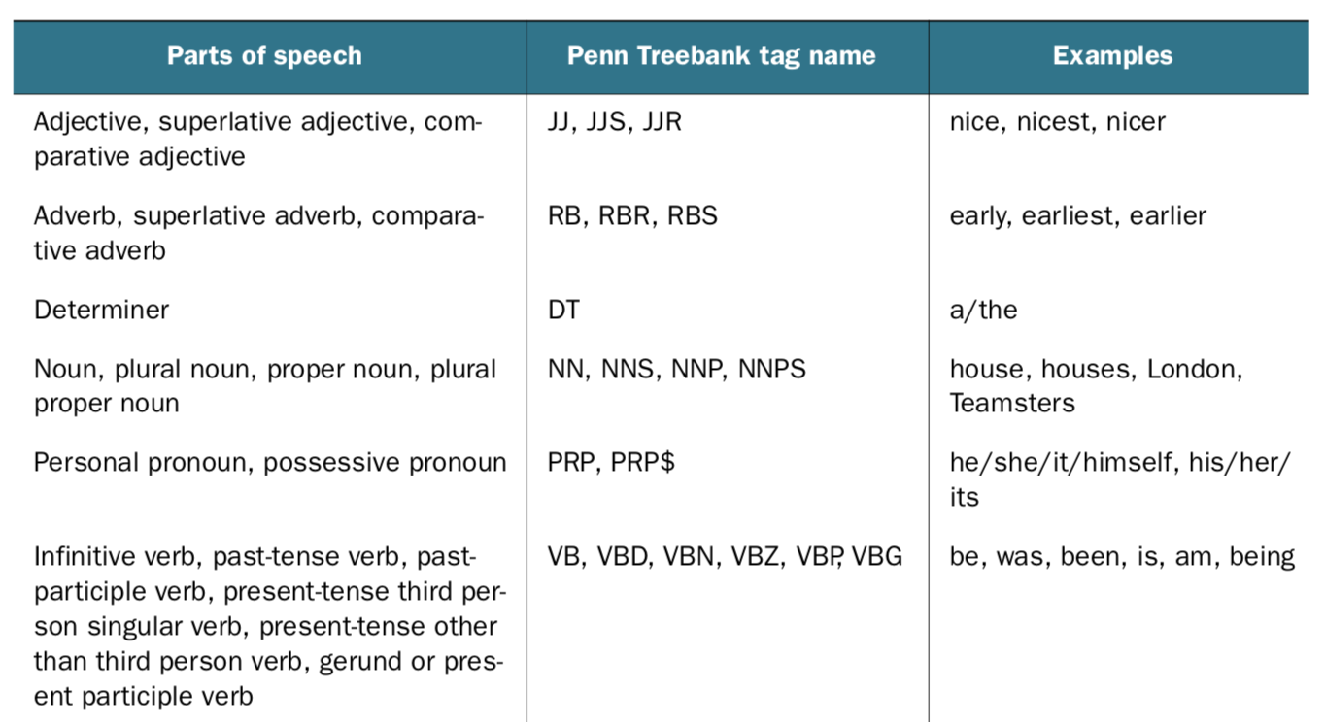
Syntactic analysis – Part of Speech (POS) Tagging
POS tagging can help determine important keywords in a document and assist in finding specific usages of a word (“Will” as a noun vs “will” as a verb)

Slide 14
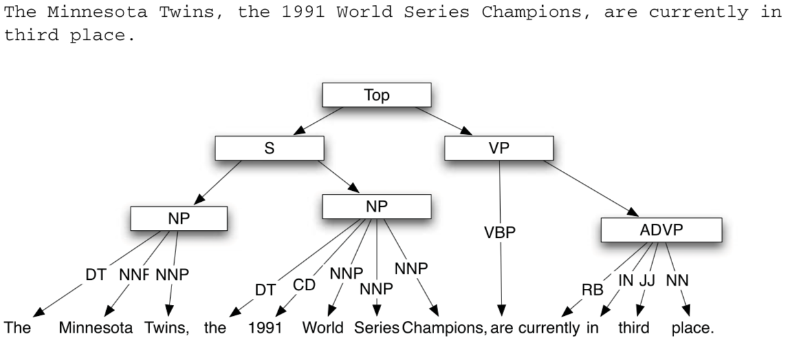
Syntactic analysis – Parsing and Grammar
Identifying verb/noun phrases and their relationships to each other can help determine the subject of a sentence along with the associated action the subject is taking.

Slide 15
Semantic analysis – "You shall know a word by the company it keeps” (Firth, J. R. 1957:11)
The process of understanding natural language – meaning of words and their relations to other words
Examples:
“dalmatian” and “dog” are semantically related.
“dalmatian” and “spotted” are more closely related than “dog” and “spotted.”
“dalmatian” is more frequently capitalized than other nouns.
“spotted” can mean “seen” or “dotted.”

Slide 16
Semantic analysis - Search example (Word sense disambiguation)
Search results for the term “jaguar”:
A luxury car
A large feline predator
A football team
An operating system
What factors influence the results that will be presented to you?
Notes:
Context
Personalization
Related terms

Slide 17
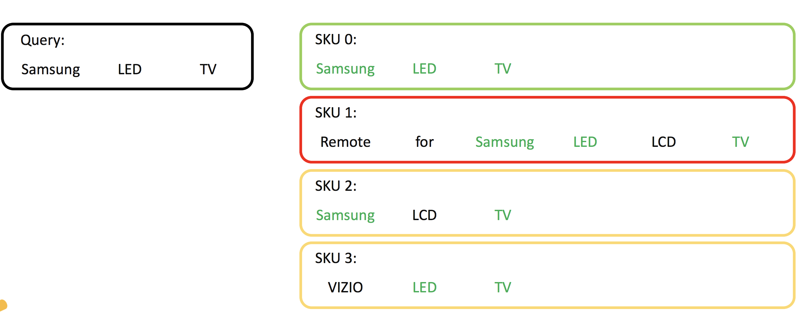
Semantic analysis – Named Entity Recognition Walmart labs example

Slide 18
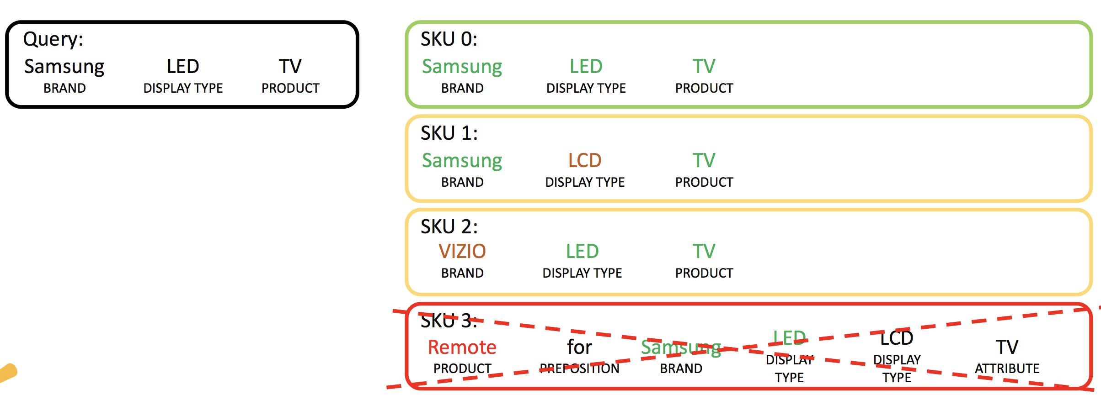
Semantic analysis – Named Entity Recognition Walmart labs example

Slide 19
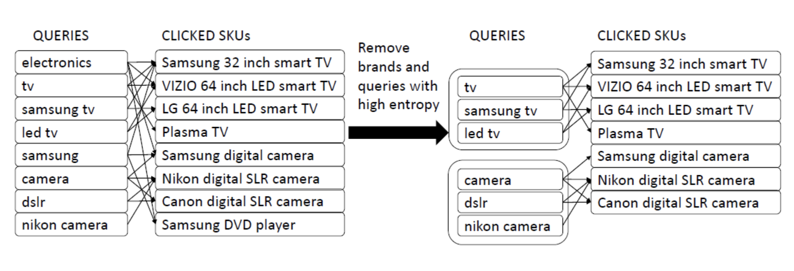
Semantic analysis – group similar queries based on customer behavior Walmart labs example

Slide 20
Classification
Categorize documents into one (or more) classes or topics
Industrial-scale: classify thousands or millions of items into thousands of categories
Real world classification system:
Chimera, VLDB’14
http://pages.cs.wisc.edu/~anhai/papers/chimera-vldb14.pdf
https://blog.acolyer.org/2016/01/28/chimera/
“Chimera employs a combination of learning, rules (created by in-house analysts), and crowdsourcing to achieve accurate, continuously improving, and cost-effective classification - 10M+ products into 5000+ categories”

Slide 21
Classification

Slide 22
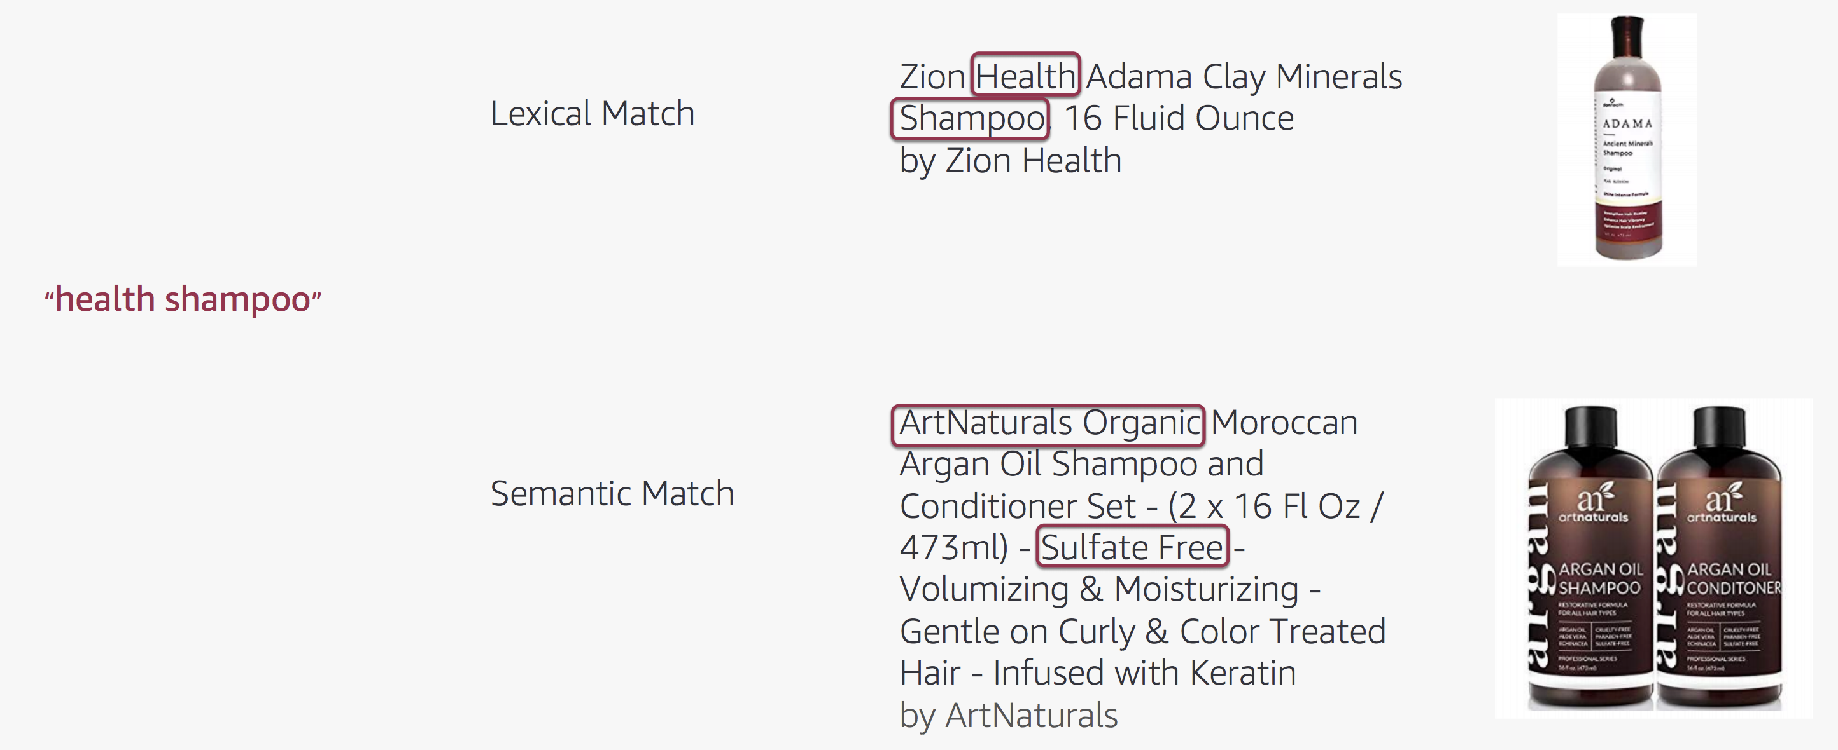
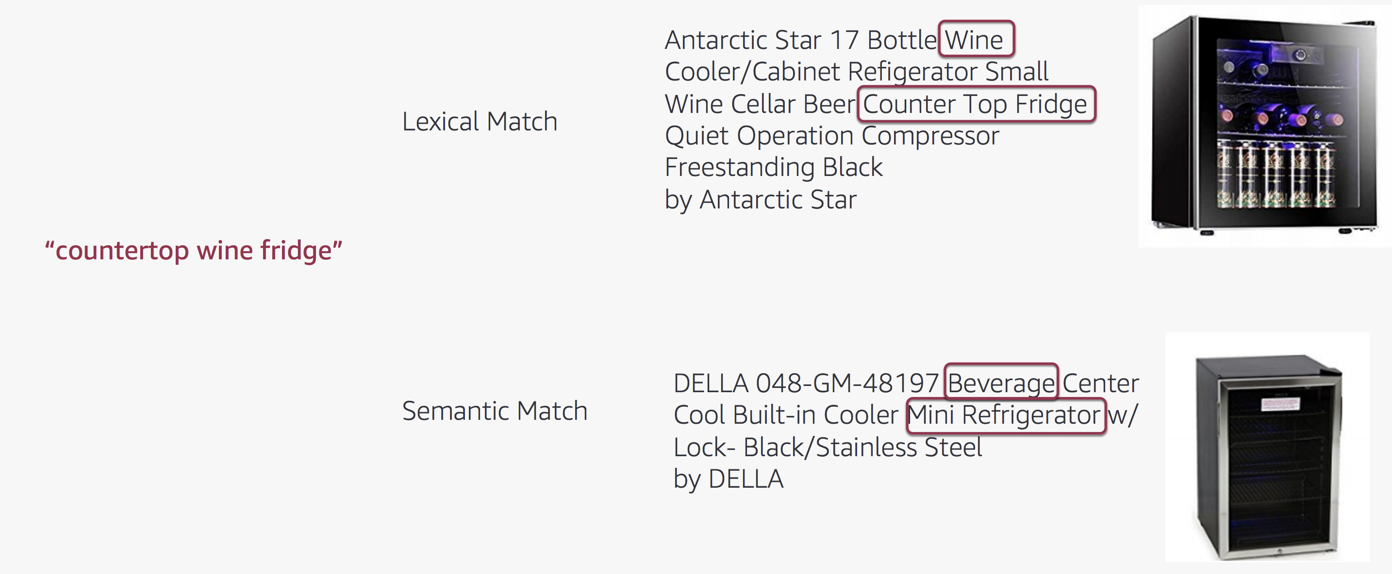
Keyword (syntax) vs Semantic Search
Search for things not strings!
Deep Semantic Matching for Amazon Product Search, Amazon, WSDM 2019
https://wsdm2019-dapa.github.io/slides/05-YiweiSong.pdf

Slide 23
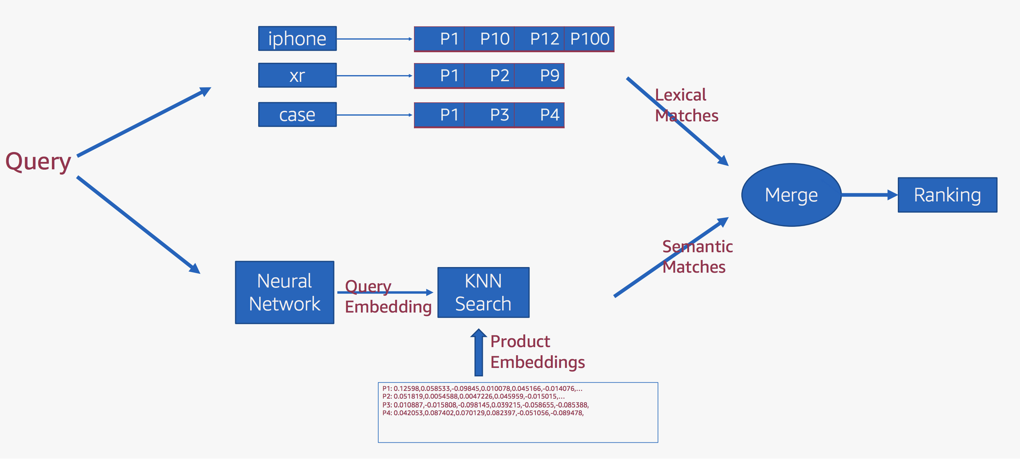
Keyword (syntax) vs Semantic Search

Slide 24
Semantic Search – Ontology Knowledge Graph powered search
Taxonomy
Hierarchical organization of entities.
Parent-child “is-a” relationships
Ontology
Arbitrary complex relationships between entities.
Is-a, has-a, uses-a .. non-hierarchical relationships

Slide 25
Text corpora for NLP
A text corpus is a collection of text sources
Training models/algorithms for specific use cases and benchmarking
Traits of a good text corpus:
Depth: e.g., a word list should include the top 30k terms and not just 3k
Recent: can you use old literature texts for current tasks?
Metadata: should indicate sources, assumptions, limitations
Genre: if not specific for a task, should include multiple genres (blogs, newspapers, academic journals, etc)
Size: at least half a million words or more – ensure low frequency/tail terms are represented
Clean
A good guide for text corpora for various tasks: https://devopedia.org/text-corpus-for-nlp

Slide 26
Text corpora for NLP - Examples
POS Tagging: Penn Treebank WSJ section, Ritter data set for social media
NER: CoNLL 2003-NER – Reuters RCV1 corpus, WNUT 2017 Emerging Entities, OntoNotes 5.0
Sentiment Analysis: IMDB, Amazon Customer Reviews, Yelp
Text Classification/Clustering: Reuters-21578, 20 Newsgroups
Question Answering: Stanford Question Answering Dataset (SQuAD), Jeopardy

Slide 27
What did you learn today?
Questions?

